Slide 1
ER Diagram

Slide 2
To create an Entity-Relationship Diagram:
Select first an element where a new Entity-Relationship Diagram to be contained as a child.
Select Model | Add Diagram | ER Diagram in Menu Bar or select Add Diagram | ER Diagram in Context Menu

Slide 3
Entity
To create an Entity:
Select Entity in Toolbox.
Drag on the diagram as the size of Entity.
You can use QuickEdit for Entity by double-click or press Enter on a selected Entity.
Name : Enter name.
Add Note : Add a linked note.
Add Column (Ctrl+Enter) : Add a column.
Add One to One : Add an one-to-one relationship with an entity.
Add One to Many : Add an one-to-many relationship with an entity.
Add Many to Many : Add an many-to-many relationship with an entity.

Slide 4
Column
To add a Column:
Select an Entity.
Select Model | Add | Column in Menu Bar or Add | Column in Context Menu.
You can use QuickEdit for Column by double-click or press Enter on a selected Column.
Column Expression : Edit column expression.
Syntax of Column Expression
column ::= name [ ':' type ] [ '(' length ')' ]
name ::= (identifier)
type ::= (identifier)
length ::= (string)

Slide 5
Column
Primary Key : Check whether the column is primary key or not.
Add (Ctrl+Enter) : Add one more column in the below.
Delete (Ctrl+Delete) : Delete the column
Move Up (Ctrl+Up) : Move the column up.
Move Down (Ctrl+Down) : Move the column down.

Slide 6
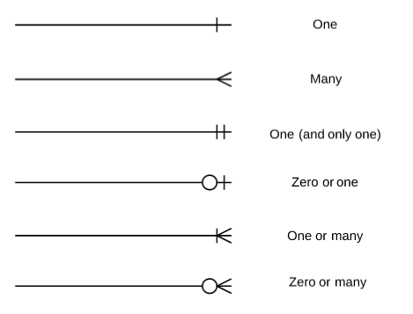
Cardinality and ordinality
Cardinality refers to the maximum number of times an instance in one entity can relate to instances of another entity.
Ordinality, on the other hand, is the minimum number of times an instance in one entity can be associated with an instance in the related entity.

Slide 7
Relationship
To create a Relationship:
Select One-to-One Relationship, One-to-Many Relationship or Many-to-Many Relationship in Toolbox.
Drag from an entity and drop on another entity.
You can use QuickEdit for Relationship by double-click or press Enter on a selected Relationship.
Name : Enter name.
Identifying : Check whether the relationship is identifying or not.
Add Note : Add a linked note.
You can also use QuickEdit for Relationship End by double-click at the end side of a Relationship.
Name : Enter name.
Cardinality : Select cardinality of the selected relationship end.

Slide 8
Problem Statement 1
Construct an E-R diagram for a car insurance company whose customers own one or more cars each. Each car has associated with it zero to any number of recorded accidents. Each insurance policy covers one or more cars, and has one or more premium payments associated with it. Each payment is for a particular period of time, and has an associated due date, and the date when the payment was received.

Slide 9
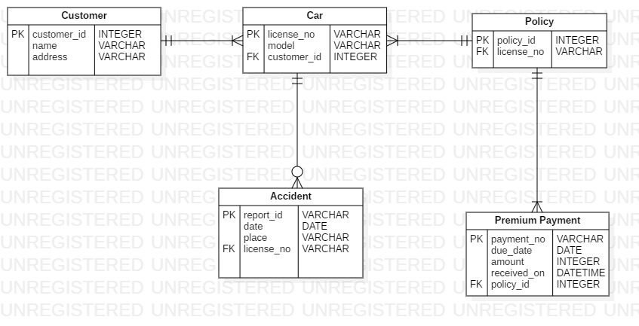
Solution

Slide 10
Problem Statements
1. A sales department (SDept-#) is uniquely assigned to a customer characteristics (Cust-#), an article characteristics (Art-#) and a sales channel (Sch-#).
2.1) An airplane (Tail-#) is assigned to several flights (Flight-#). A flight is assigned to only one airplane.
2.2) A pilot (SocialSec-ID) can perform several flights. A flight is performed by several (normally at least two) pilots.
3.1) A supplier (Supp-#) processes many purchase orders (PO-#) and sells a number of products (Prod-#). A product is sold by only one supplier.
3.2) Each of the purchase orders that a supplier may process includes several products. The relationship between order and product is defined as "Line Item".
3.3) A customer (Cust-#) may place one or more purchase orders. A purchase order may be placed by only one customer.

Slide 11
Thank you

